Slide 1
Exploring LA Neighborhoods
IBM capstone project
Author: Charlotte Huang

Slide 2
Introduction
Los Angeles is one of the most popular cities in the US
more people from different walks of life are moving to LA
facing big difficulties of choosing neighborhoods
aims to cluster all neighborhoods in LA according to their venues and provide people with some suggestions about each neighborhood

Slide 3
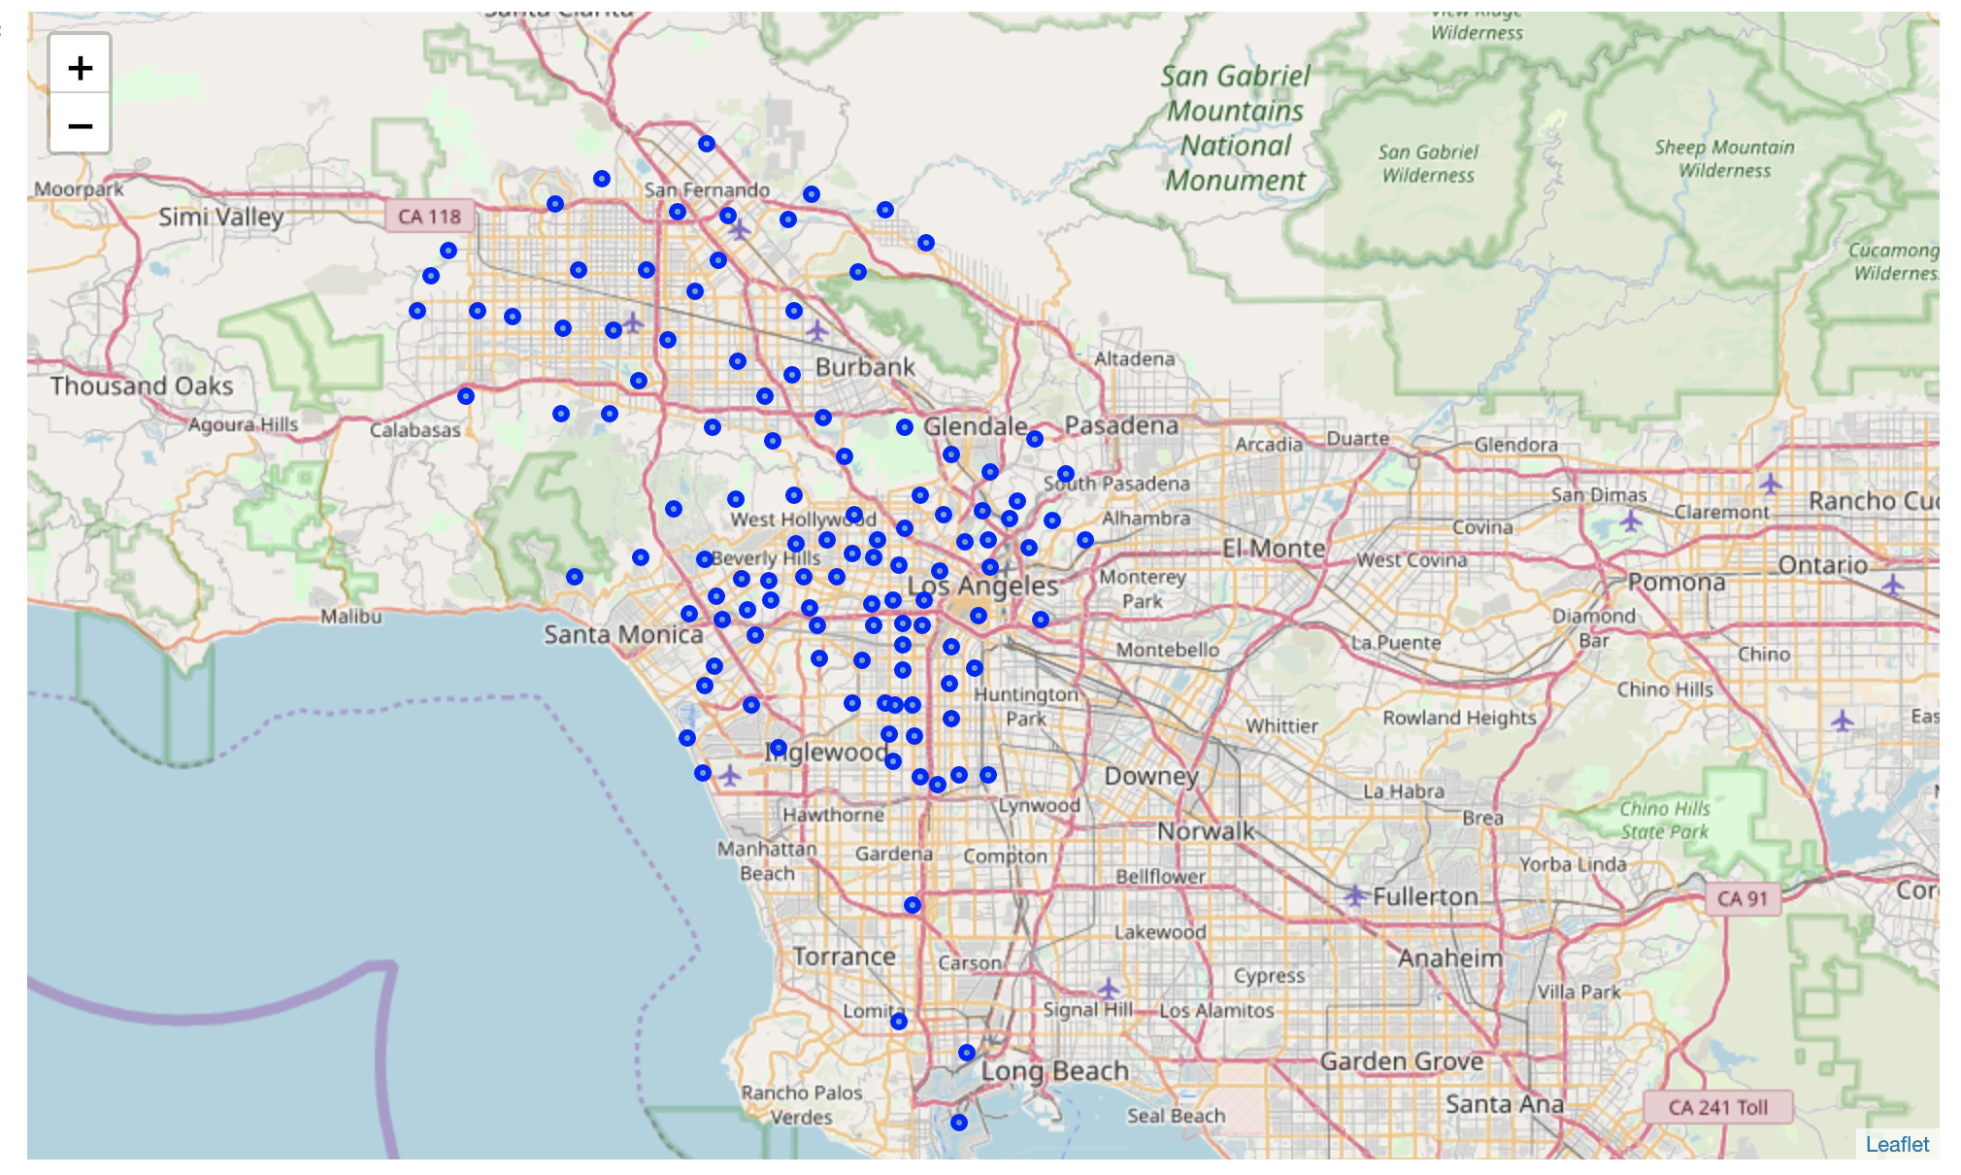
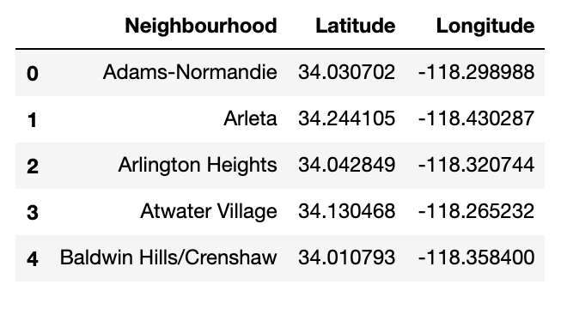
Dataset
LA neighborhood

Slide 4
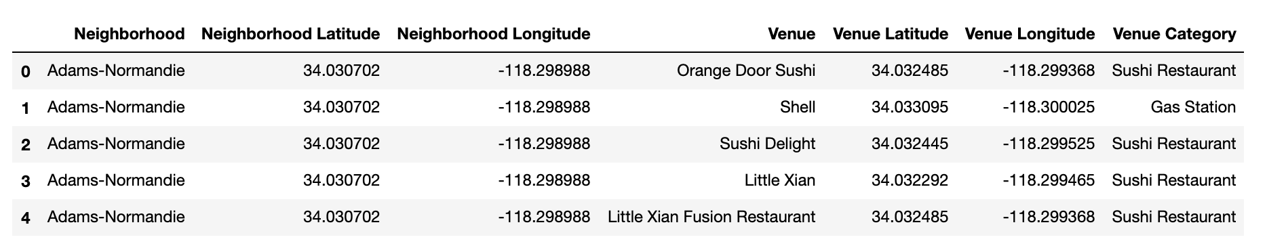
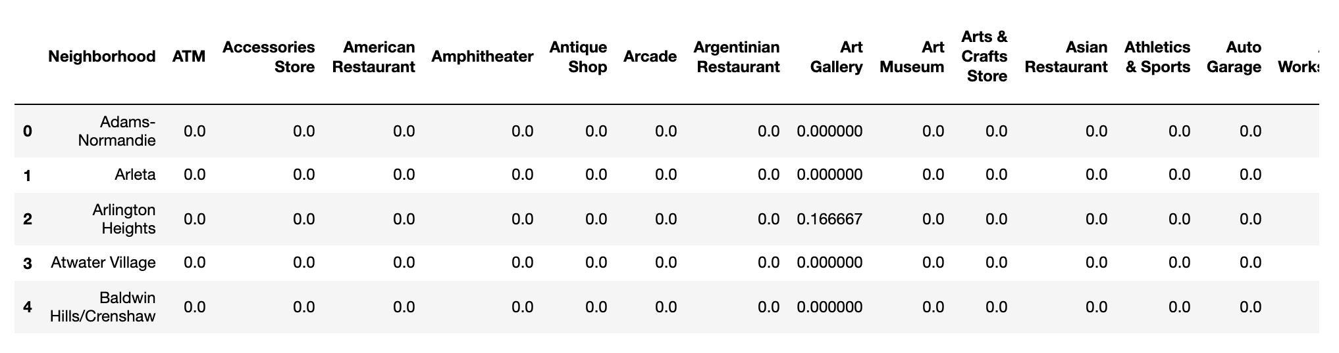
Dataset
FourSqaure API
Dummy coding

Slide 5
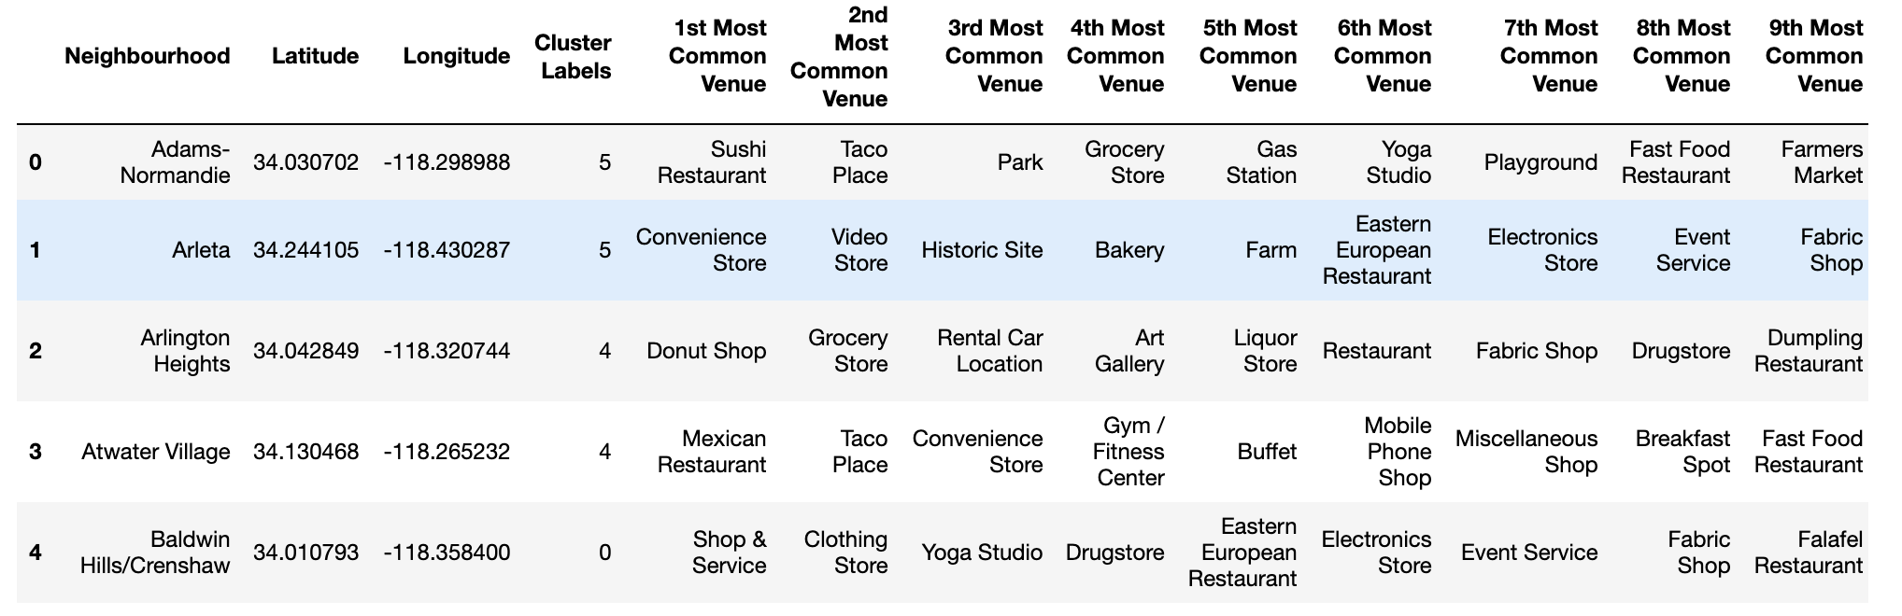
Machine Learning
Clustering (K-means)
K = 6

Slide 6
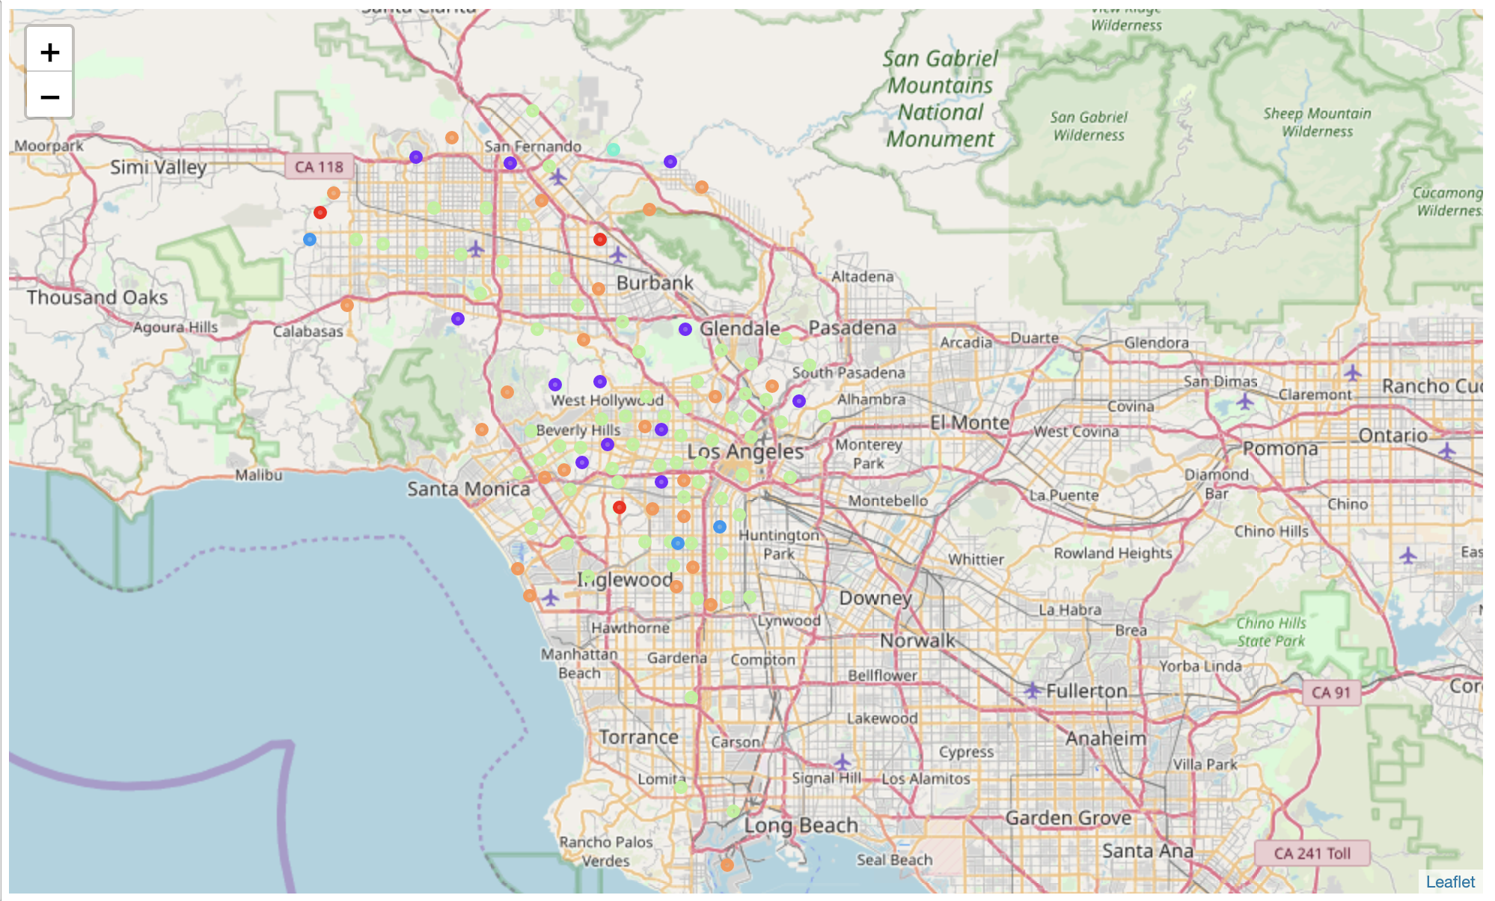
Results

Slide 7
Results
The First cluster has 3 neighborhoods. Their most common venues are different types of shops, including sports, cloths and drugstores. This cluster is suitable for those who enjoying shopping and have high commodity demand.
The Third cluster has 3 neighborhoods. Interestingly enough, their most common venues are parks and yoga studios. This cluster is especially favorable for those who enjoy life and will take some time every day to exercise.
The Fourth cluster contain most number of neighborhoods. Therefore, their common venues vary a lot across different neighborhoods. However, they generally have restaurants, grocery stores, and some entertaining places. This cluster can satisfy most people's needs.

